Slide 1

Getting Started with PowerPoint 2007
Information Classification: Internal Use Only

Slide 2
Objective
Create an effective and quality presentation using Microsoft PowerPoint 2007.

Slide 3
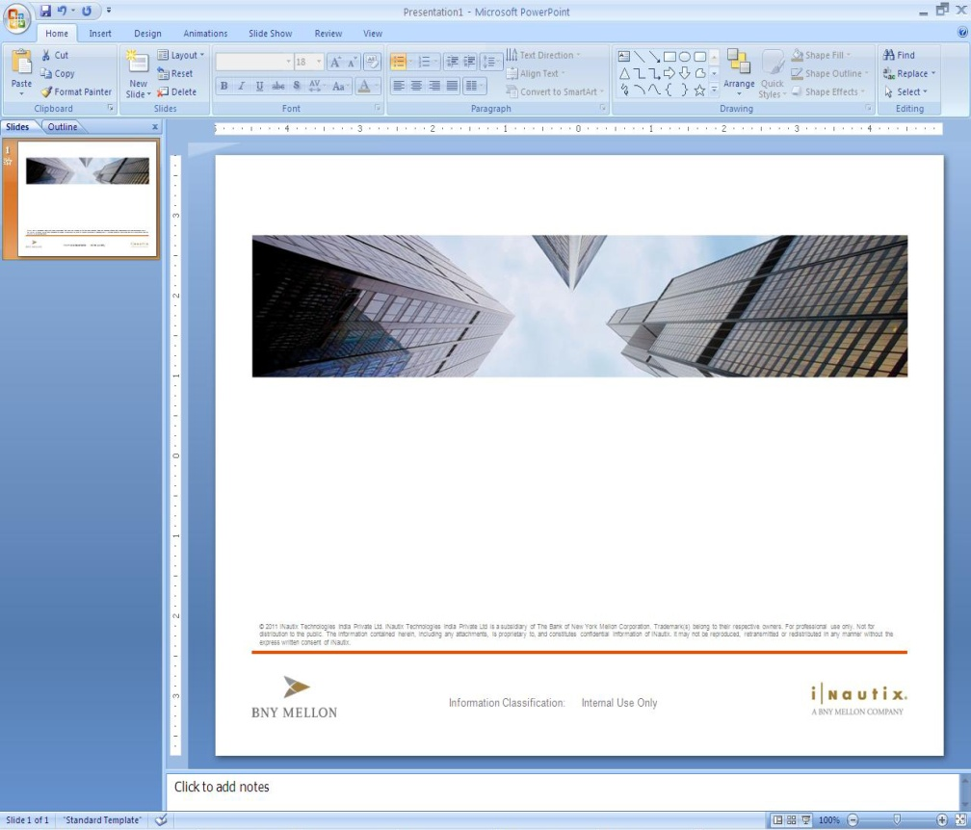
The PowerPoint Environment
To launch PowerPoint, use Start | Programs | Microsoft Office |
Microsoft Office PowerPoint 2007
The Ribbon
Office Button
The slide Area is shown in the centre.
On the left is the Slide and Outline tabs, which let you quickly, switch to different PowerPoint views.
Quick Access Bar
Notes Window for adding speaker notes.
View Selector and the Help Button.
Quick Access Toolbar
The Ribbon
Help Button
Office Button
Slide Tab
Thumbnail Pane
Notes Window
Slide Area
View Selector

Slide 4

Views
Views allow you to see presentations in a number of different ways. The available views are Normal, Slide Sorter, Notes Page and Slide Show. They are easiest to understand using an existing PowerPoint presentation.
To change a view, either choose one of the four options from the top part of the View menu or use one of the three shortcut icons at the bottom of the PowerPoint window.
Normal View
Slide Sorter View
Notes Page View
Slide Show
Views
Zoom Buttons and Slider

Slide 5
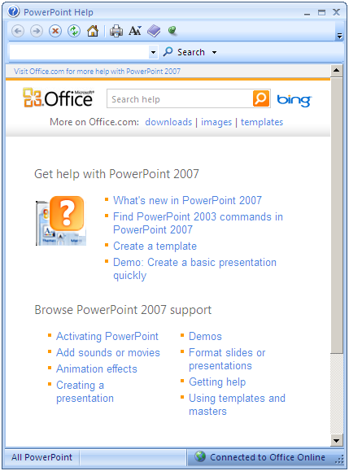
Getting Help – F1
There are several ways to obtain help in PowerPoint similar to Microsoft Word and Excel.
Offline Help
Online Help
Keyword Search
Tutorial (Training)
Presentations
Downloads
Templates
Browse Support

Slide 6
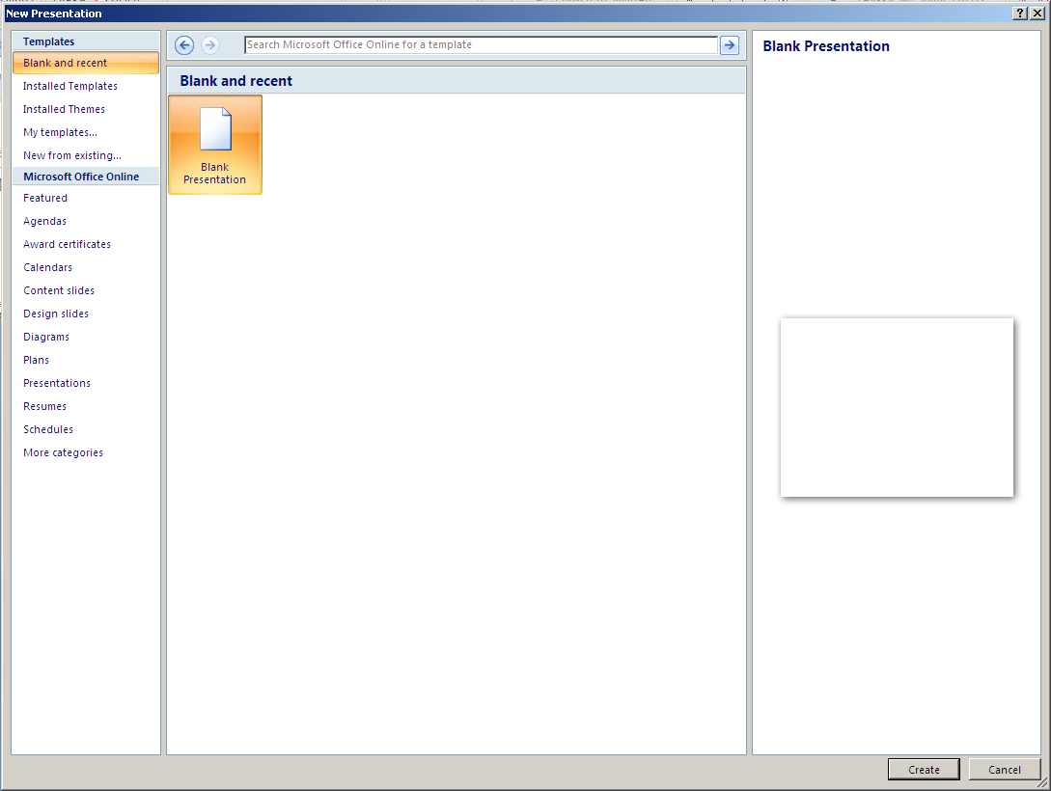
Creating Presentations – New Presentation

Slide 7
Entering Text
Entering text within a placeholder
Promoting and demoting bullets
Moving bullets up and down
Entering text in a text box
Indenting list levels
Text Direction

Slide 8
Editing your Presentation
Select the content:
Single click – to place the cursor on the content
Double click – to select a word
Triple click – to select the entire content within the place holder
Cut
Copy
Paste
Delete
Spell Check – Ignore, Ignore All, Change, Change All, Add, Suggest, Autocorrect

Slide 9

Formatting Slides
Formatting governs the shape, appearance, size and colour of the content. The content has to be selected before formatting can be applied.
Bold, Italics, Underline, Font, Font Size, Font Color, Change case, Applying other text effects, Aligning text, Line spacing, Text Box formatting, text box fill color, line color, Modifying bullet and numbering styles, Inserting symbols, etc.
Increase font size
Decrease font size
Font size box

Slide 10
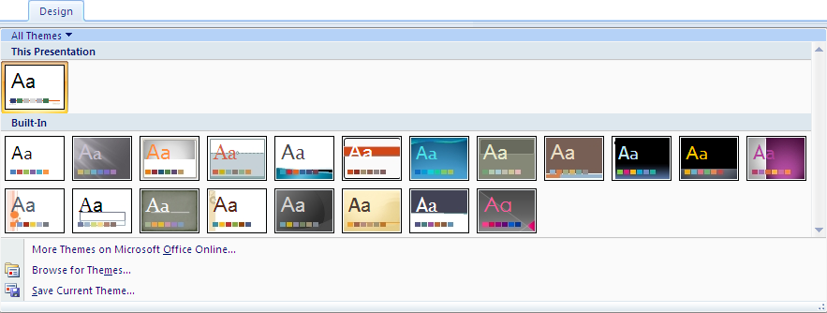
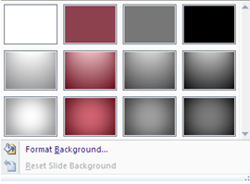
Using Design Templates
The easiest way to apply wholesale changes to the appearance of all aspects of a presentation (text, layout and colour scheme) is to apply a different Design Template.
Applying a design to a new presentation – From Design Menu
Background Styles:

Slide 11
Editing and Moving Slides
Adding new slides – Insert | New Slide or Ctrl + M
Duplicating slides - Insert | Duplicate Slide
Deleting slides – Edit |Delete Slide or press Del
Moving between slides – Use Page Up, Page Down, Home, End keys, Scroll Bars
Using Slide Sorter view
Selection of Multiple Slide – Use Ctrl Key and select the required slides.
To Select All – Ctrl A

Slide 12
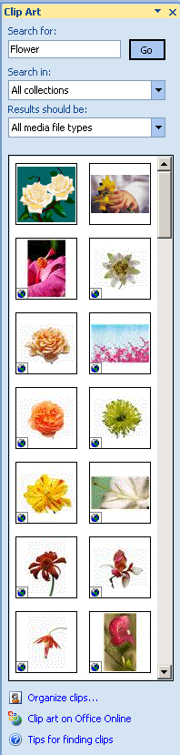
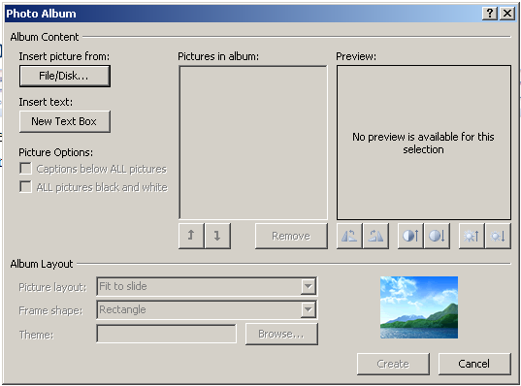
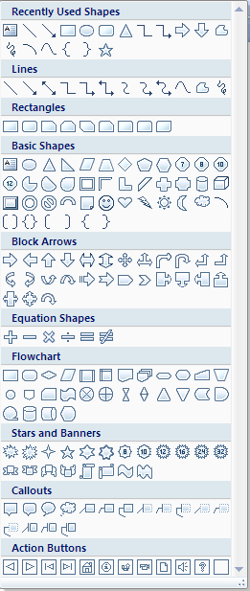
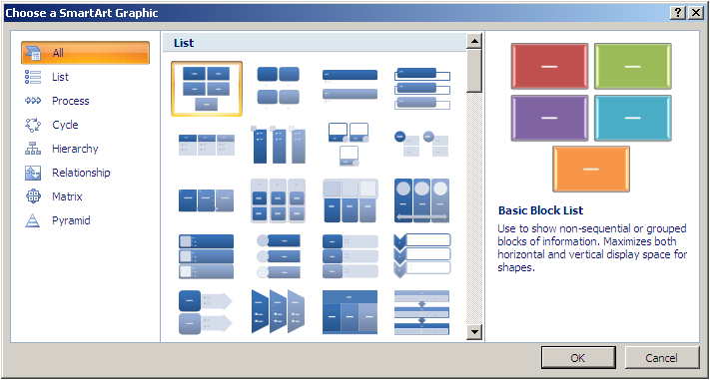
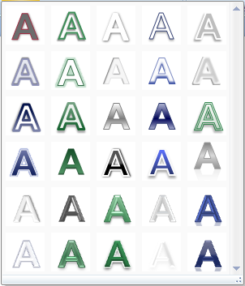
Incorporating Graphics
Picture
Once you have inserted an image or Clip Art into your presentation, the Picture toolbar appears, offering options for modifying the graphic as indicated:
Clip Art
Photo Album
Shapes
Smart Art
Word Art

Slide 13
Running a Presentation
A slide show can be started in several ways. One way is to save a presentation in such a way that whenever you open it, it always starts as a slide show. – PowerPoint Show
Another way is to start a slide show from within PowerPoint.
Alternatively, you can create a shortcut on your desktop and start the slide show from there.
You may either start the slide show from the beginning of the presentation (slide 1) or from the current slide.
You can also set up a self-running presentation, at a kiosk or booth, for example, that will run in an ever-repeating loop.

Slide 14
Running a Presentation Contd...
Starting the slide show from the beginning
Choose View | Slide Show or press the F5 key on the keyboard.
The slide show will commence at slide 1.
Starting the slide show from the current slide – Shift + F5
With your presentation open on your screen, ensure you are positioned on the slide you want to start with. Click the Slide Show button in the lower-left corner of the presentation window.
Starting a Slide Show from your desktop
In My Computer or Windows Explorer, locate the file you want to open as a slide show.
Right-click the file name, and then click Show or create a shortcut on your desktop and start the show from there.
Save a presentation to always open as a slide show - .pps

Slide 15
Running a Presentation (Contd..)
Controlling the Presentation Manually by
To move to the next slide:
Click with mouse
Press Enter, Page Up key or → Key on the Keyboard
Press the Space Bar key
Press N
Clicking the arrow symbol at the bottom left of your screen, or right-clicking with your mouse over the slide to reveal the shortcut menu and select Next.
To move back to the previous slide:
Press Backspace, Page Down, or ← on the keyboard,
Press P (for previous),
Right-click with the mouse to display the shortcut menu and select Previous.

Slide 16
Slide Show Controls
When you’re running a slide show, you have the following controls:
To Do this
Advance to the next slide Click the mouse
Return to the previous slide Press Backspace
Go to a slide Type the slide number, and then press Enter
Black or unblack the screen Press B
White or unwhite the screen Press W
Show or hide the arrow pointer Press A
Stop/Restart Automatic Show Press S
End slide show Press Esc
Erase drawing on-screen Press E
Go to next slide, if it's hidden Press H
Rehearse with new timings Press T
Rehearse with original timings Press O

Slide 17
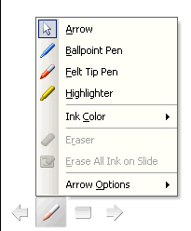
Slide Show Control (Contd..)
To Do this
Rehearse with mouse-click advance Press M
Return to the first slide Hold both mouse buttons down for two seconds
Change pointer to pen Ctrl+P
Change pen to pointer Ctrl+A
Hide pointer and button Ctrl+H
Hide pointer and button always Ctrl+L
Display shortcut menu Right mouse click
Helpful Hint:
You can press F1 during a slide show to see the list of controls.
You can select the pointer, pen and ink colour by clicking the arrow symbol at the bottom-left of your screen, or right-click with your mouse over the slide to reveal the shortcut menu.

Slide 18
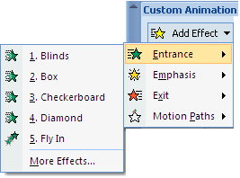
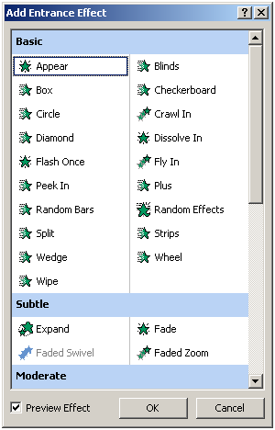
Applying Animations or Builds
Animations (known as Builds in older versions of PowerPoint) apply to the content of slides.
To Add an Animation Using Animations Menu
Animations may be applied to the current slide, to all slides, or to selected slides.
To Remove an Animation
Click on Animation on the Task Pane and delete it.
Select all to delete all animations set in the slide.

Slide 19
Applying Slide Transitions
Transitions determine how a slide appears on screen.
Applying appropriate Transition Effect in Slides
Using the Slide Sorter View
Using the Normal View - Menu Slide Show | Slide Transition
To Remove a Slide Transition
Click on the slide and select No Animation in the Animation Menu.
Select all to delete all animations set in the slide.

Slide 20
Activity
Create a PowerPoint presentation specific to any topic in your choice incorporating all the features learned.
Evaluation Criteria
Professional Flow of the presentation
Usage of appropriate features.
Minimum of 10 slides to be present.

Slide 21
Thank You

